Slide 1
Chapter 4
How to define and use functions and modules

Slide 2
Objectives (part 1)
Applied
Define and use functions in your programs including the use of default values, named arguments, local variables, and global variables.
Create, document, import, and use your own modules.
Import and use the random module.
Use a hierarchy chart or outline to plan the functions of a program.
Knowledge
In general terms, describe how to define a function, including the use of a return statement.
In general terms, describe how to call a function.
In general terms, describe how to define and call a main() function.

Slide 3
Objectives (part 2)
Describe the use of default values in a function definition and in the statements that call the function.
Describe the use of named arguments in calling statements.
Describe the recommended use of global variables, local variables, and global constants.
In general terms, explain how to create and document a module.
Distinguish among importing a module into the default namespace, a specified namespace, and the global namespace.
Describe how to use Python standard modules, such as the random module.
Describe the problem that can occur if you import a module into the global namespace.
Explain how to use a hierarchy chart or outline to plan the functions of a program.

Slide 4
The syntax for defining a function
def function_name([arguments]):
statements

Slide 5
A function that doesn’t accept arguments
How to define it
def print_welcome():
print("Welcome to the Future Value Calculator")
print()
How to call it
print_welcome() # prints welcome message

Slide 6
A function that has one argument
How to define it
def print_welcome(message):
print(message)
print()
How to call it
message = "Welcome to the Future Value Calculator"
print_welcome(message) # prints welcome message

Slide 7
A function that accepts two arguments and returns a value
How to define it
def calculate_miles_per_gallon(miles_driven, gallons):
mpg = miles_driven / gallons
mpg = round(mpg, 1)
return mpg
How to call it
miles = 500
gallons = 14
mpg = calculate_miles_per_gallon(miles, gallons) # 35.7

Slide 8
A main() function that calls another function
#!/usr/bin/env python3
def main():
# display a welcome message
print("The Future Value Calculator\n")
# get input
monthly_investment = float(input(
"Enter monthly investment: "))
yearly_interest = float(input(
"Enter yearly interest rate: "))
years = int(input(
"Enter number of years: "))
# get the future value
future_value = calculate_future_value(
monthly_investment, yearly_interest, years)
# display output
print("Future value: ", round(future_value, 2))

Slide 9
Two ways to call a main() function
Code a simple call statement (not recommended)
main()
Code a call statement within an if statement that checks if current module is main module
if __name__ == "__main__": # if main module
main() # call main() function

Slide 10
The user interface for the Future Value program
Enter monthly investment: 100
Enter yearly interest rate: 12
Enter number of years: 10
Future value: 23233.91
Continue? (y/n):

Slide 11
The code for the Future Value program (part 1)
#!/usr/bin/env python3
def calculate_future_value(monthly_investment, yearly_interest,
years):
# convert yearly values to monthly values
monthly_interest_rate = yearly_interest / 12 / 100
months = years * 12
# calculate future value
future_value = 0.0
for i in range(0, months):
future_value += monthly_investment
monthly_interest = future_value * monthly_interest_rate
future_value += monthly_interest
return future_value

Slide 12
The code for the Future Value program (part 2)
def main():
choice = "y"
while choice.lower() == "y":
# get input from the user
monthly_investment = float(input(
"Enter monthly investment:\t"))
yearly_interest_rate = float(input(
"Enter yearly interest rate:\t"))
years = int(input("Enter number of years:\t\t"))
# get and display future value
future_value = calculate_future_value(
monthly_investment, yearly_interest_rate, years)
print("Future value:\t\t\t"
+ str(round(future_value, 2)))
print()

Slide 13
The code for the Future Value program (part 3)
# see if the user wants to continue
choice = input("Continue? (y/n): ")
print()
print("Bye!")
if __name__ == "__main__":
main()

Slide 14
A function with a default value
def calculate_future_value(monthly_investment,
yearly_interest, years=20):
# convert yearly values to monthly values
monthly_interest_rate = yearly_interest / 12 / 100
months = years * 12
# calculate future value
future_value = 0.0
for i in range(0, months):
future_value += monthly_investment
monthly_interest = future_value *
monthly_interest_rate
future_value += monthly_interest
return future_value

Slide 15
How to call the function and use its default value
future_value = calculate_future_value(100, 8.5)
How to call the function and override its default value
future_value = calculate_future_value(100, 8.5, 10)

Slide 16
How to use default values in your function definitions
You can specify a default value for any argument in a function definition by assigning a value to the argument. However, the arguments with default values must be coded last in the function definition.
When you call a function, any arguments that have default values are optional. But you can override the default value for an argument by supplying that argument.

Slide 17
How to call the function with named arguments
future_value = calculate_future_value(
years=10,
monthly_investment=100,
yearly_interest=8.5)

Slide 18
How to use named arguments in your calling statements
To code a named argument, code the name of the argument in the function definition, an equals sign, and the value or variable for the argument.
If you call a function without named arguments, you must code them in the same sequence that they’re coded in the function definition.
If you call a function with named arguments, you don’t have to code the arguments in the sequence that they’re coded in the function definition.
It’s a good practice to use named arguments for functions that have many arguments. This can improve the readability of the code and reduce errors.

Slide 19
Functions that use local variables
def calc_tax(amount, tax_rate):
tax = amount * tax_rate # tax is local variable
return tax # return is necessary
def main():
tax = calc_tax(85.0, .05) # tax is local variable
print("Tax:", tax) # Tax 4.25

Slide 20
A function that changes a global variable (not recommended)
tax = 0.0 # tax is global variable
def calc_tax(amount, tax_rate):
global tax # access global variable
tax = amount * tax_rate # change global variable
def main():
calc_tax(85.0, .05)
print("Tax:", tax) # Tax 4.25 (global)

Slide 21
A local variable that shadows a global variable (not recommended)
tax = 0.0 # tax is global variable
def calc_tax(amount, tax_rate):
tax = amount * tax_rate # tax is local variable
print("Tax:", tax) # Tax 4.25 (local)
def main():
calc_tax(85.0, .05)
print("Tax:", tax) # Tax 0.0 (global)

Slide 22
A function that uses a global constant (OK to use)
TAX_RATE = 0.05 # TAX_RATE is global
def calc_tax(amount):
tax = amount * TAX_RATE # use constant here
return tax

Slide 23
The temperature.py file (temperature module)
def to_celsius(fahrenheit):
celsius = (fahrenheit - 32) * 5/9
return celsius
def to_fahrenheit(celsius):
fahrenheit = celsius * 9/5 + 32
return fahrenheit
# the main() function is used to test the other functions
# this code isn't run if this module isn't the main module
def main():
for temp in range(0, 212, 40):
print(temp, "Fahrenheit =",
round(to_celsius(temp)), "Celsius")
for temp in range(0, 100, 20):
print(temp, "Celsius =",
round(to_fahrenheit(temp)), "Fahrenheit")
# if this module is the main module, call the main() function
# to test the other functions
if __name__ == "__main__":
main()

Slide 24
The console when you run the temperature module
0 Fahrenheit = -18 Celsius
40 Fahrenheit = 4 Celsius
80 Fahrenheit = 27 Celsius
120 Fahrenheit = 49 Celsius
160 Fahrenheit = 71 Celsius
200 Fahrenheit = 93 Celsius
0 Celsius = 32 Fahrenheit
20 Celsius = 68 Fahrenheit
...

Slide 25
The temperature module with documentation
"""
This module contains functions for converting
temperature between degrees Fahrenheit
and degrees Celsius
"""
def to_celsius(fahrenheit):
"""
Accepts degrees Fahrenheit (fahrenheit argument)
Returns degrees Celsius
"""
celsius = (fahrenheit - 32) * 5/9
return celsius
def to_fahrenheit(celsius):
"""
Accepts degrees Celsius (celsius argument)
Returns degrees Fahrenheit
"""
fahrenheit = celsius * 9/5 + 32
return fahrenheit

Slide 26
How to view the documentation for a module
>>> import temperature
>>> help(temperature)
Help on module temperature:
NAME
temperature
DESCRIPTION
This module contains functions for converting
temperature between degrees Fahrenheit
and degrees Celsius
FUNCTIONS
to_celsius(fahrenheit)
Accepts degrees Fahrenheit (fahrenheit argument)
Returns degrees Celsius
to_fahrenheit(celsius)
Accepts degrees Celsius (celsius argument)
Returns degrees Fahrenheit

Slide 27
The syntax for importing a module into a local namespace
import module_name [as namespace]
Importing into the module’s default namespace
import temperature
Code that calls its functions
c = temperature.to_celsius(f)
f = temperature.to_fahrenheit(c)
Importing into a specified namespace
import temperature as temp
Code that calls its functions
c = temp.to_celsius(f)
f = temp.to_fahrenheit(c)

Slide 28
The syntax for importing into the global namespace (not recommended)
from module_name import function_name1[, function_name2]...
Importing one function into the global namespace
from temperature import to_celsius
Code that calls its functions
c = to_celsius(f)
f = to_fahrenheit(c) # Error! Function not imported
Importing all functions into the global namespace
from temperature import *
Code that calls its functions
c = to_celsius(f)
f = to_fahrenheit(c)

Slide 29
User interface: The Convert Temperatures program
MENU
1. Fahrenheit to Celsius
2. Celsius to Fahrenheit
Enter a menu option: 1
Enter degrees Fahrenheit: 99
Degrees Celsius: 37.2
Convert another temperature? (y/n): n

Slide 30
The Convert Temperatures program (part 1)
import temperature as temp
def display_menu():
print("MENU")
print("1. Fahrenheit to Celsius")
print("2. Celsius to Fahrenhit")
print()
def convert_temp():
option = int(input("Enter a menu option: "))
if option == 1:
f = int(input("Enter degrees Fahrenheit: "))
c = temp.to_celsius(f)
c = round(c, 2)
print("Degrees Celsius:", c)
elif option == 2:
c = int(input("Enter degrees Celsius: "))
f = temp.to_fahrenheit(c)
f = round(f, 2)
print("Degrees Fahrenheit:", f)
else:
print("You must enter a valid menu number.")

Slide 31
The Convert Temperatures program (part 2)
def main():
display_menu()
again = "y"
while again.lower() == "y":
convert_temp()
print()
again = input("Convert another temperature? (y/n): ")
print()
print("Bye!")
if __name__ == "__main__":
main()

Slide 32
Some of the standard modules presented in this book
math
random
decimal
csv
pickle
tkinter

Slide 33
Three functions of the random module
random()
randint(min, max)
randrange([start,] stop [,step])

Slide 34
A statement that imports the random module
import random
Examples that use the random module
# the use of the random method
number = random.random() # float >= 0.0 and < 1.0
number = random.random() * 100 # float >= 0.0 and < 100.0
# the use of the randint method
number = random.randint(1, 100) # int from 1 to 100
number = random.randint(101, 200) # int from 101 to 200
number = random.randint(0, 7) # int from 0 to 7
# the use of the randrange method
number = random.randrange(1, 100) # int from 1 to 99
number = random.randrange(
100, 200, 2) # even int from 100 to 198
number = random.randrange(
11, 250, 2) # odd int from 11 to 249

Slide 35
Code that simulates rolling a pair of dice
die1 = random.randint(1, 6) # assume 6 is returned
die2 = random.randint(1, 6) # assume 5 is returned
print("Your roll:", die1, die2) # Your roll: 6 5

Slide 36
The user interface for the Guess the Number game
Guess the Number!
I'm thinking of a number from 1 to 10
Your guess: 5
Too low.
Your guess: 8
You guessed it in 2 tries.
Would you like to play again? (y/n): n
Bye!

Slide 37
The code for the Guess the Number game (part 1)
import random
LIMIT = 10
def display_title():
print("Guess the number!\n")
def play_game():
number = random.randint(1, LIMIT)
print("I'm thinking of a number from 1 to "
+ str(LIMIT) + "\n")
count = 1
while True:
guess = int(input("Your guess: "))
if guess < number:
print("Too low.")
count += 1
elif guess > number:
print("Too high.")
count += 1
elif guess == number:
print("You guessed it in "
+ str(count) + " tries.\n")
return

Slide 38
The code for the Guess the Number game (part 2)
def main():
display_title()
again = "y"
while again.lower() == "y":
play_game()
again = input("Would you like to play again? (y/n): ")
print()
print("Bye!")
# if started as the main module, call the main() function
if __name__ == "__main__":
main()

Slide 39
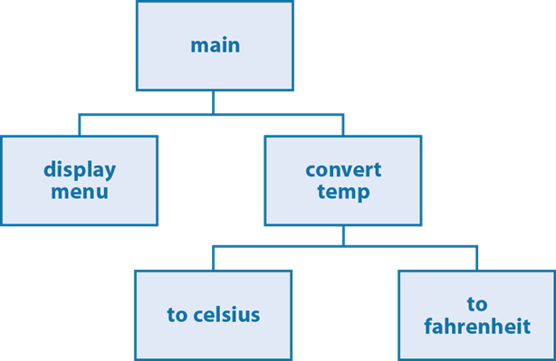
Hierarchy chart: Convert Temperatures program
A hierarchy outline for the same program
main
display menu
convert temp
to celsius
to fahrenheit

Slide 40
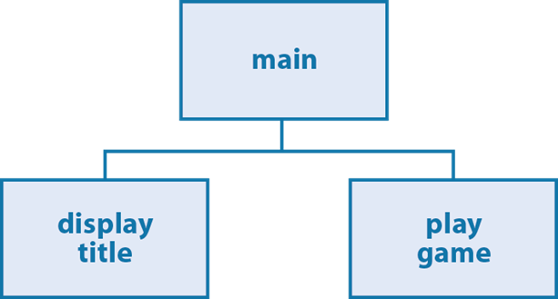
Hierarchy chart: Guess the Number game

Slide 41
How to build a hierarchy chart
Start with a box for the main() function.
At the next level, put boxes for the functions that the main() function needs to call. This usually includes the function that will control the main action of the program, plus any functions that need to be done before or after that function.
Continue down the levels by dividing the higher-level functions into their component functions until there aren’t any more components.

Slide 42
Guidelines for creating hierarchy charts
The names in a chart should start with a verb and give a good indication of what the function does. Then, the names can easily be converted to Python function names.
Each function should do everything that is related to the function name and nothing more. The code shouldn’t be split between two or more functions.

Slide 43
The rules for a Pig Dice game
For each turn, the player can choose to roll the die or hold.
A turn ends when the player rolls a 1 or chooses to hold.
If the player rolls a 1, all points are lost for that turn.
If the player chooses to hold, all points for that turn are added to the total.
If the player enters an invalid character, the roll or hold prompt is displayed and the player can make another entry.
When a player reaches 20 points, the game ends and the number of turns is displayed.

Slide 44
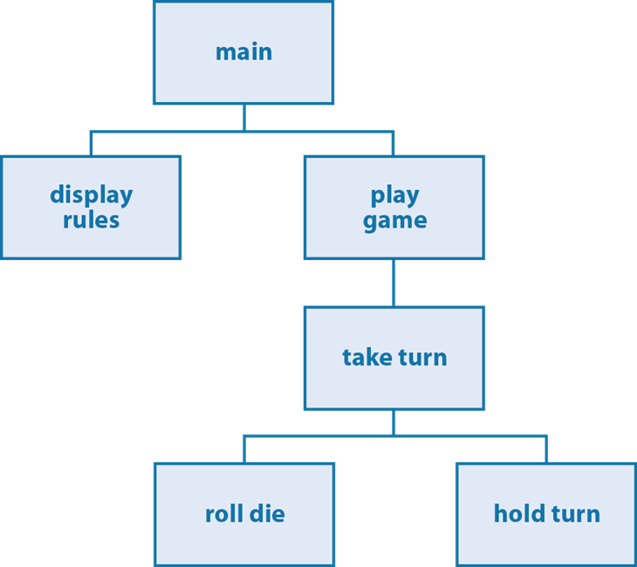
A hierarchy chart for the Pig Dice game

Slide 45
The user interface for the Pig Dice game
TURN 1
Roll or hold? (r/h): r
Die: 4
Roll or hold? (r/h): h
Score for turn: 4
Total score: 4
TURN 2
Roll or hold? (r/h): r
Die: 1
Turn over. No score.
...
...
You finished in 4 turns!

Slide 46
The Pig Dice game with global variables (part 1)
import random
# global variables
turn = 1
score = 0
score_this_turn = 0
turn_over = False
game_over = False
def main():
display_rules()
play_game()
def display_rules():
print("Let's Play PIG!")
print()
print("* See how many turns it takes you to get to 20.")
print("* Turn ends when you hold or roll a 1.")
print("* If you roll a 1, you lose all points for the turn.")
print("* If you hold, you save all points for the turn.")
print()

Slide 47
The Pig Dice game with global variables (part 2)
def play_game():
while not game_over:
take_turn()
print()
print("Game over!")
def take_turn():
global turn_over
print("TURN", turn)
turn_over = False
while not turn_over:
choice = input("Roll or hold? (r/h): ")
if choice == "r":
roll_die()
elif choice == "h":
hold_turn()
else:
print("Invalid choice. Try again.")

Slide 48
The Pig Dice game with global variables (part 3)
def roll_die():
global turn, score_this_turn, turn_over
die = random.randint(1, 6)
print("Die:", die)
if die == 1:
score_this_turn = 0
turn += 1
print("Turn over. No score.\n")
turn_over = True
else:
score_this_turn += die
def hold_turn():
global turn, score_this_turn, score, turn_over, game_over
print("Score for turn:", score_this_turn)
score += score_this_turn
score_this_turn = 0
print("Total score:", score, "\n")

Slide 49
The Pig Dice game with global variables (part 4)
turn_over = True
if score >= 20:
game_over = True
print("You finished in", turn, "turns!")
turn += 1
# if started as the main module, call the main() function
if __name__ == "__main__":
main()

Slide 50
The Pig Dice functions with local variables (part 1)
def play_game():
turn = 1
score = 0
game_over = False
while not game_over:
turn, score, game_over = take_turn(
turn, score, game_over)
print()
print("Game over!")

Slide 51
The Pig Dice functions with local variables (part 2)
def take_turn(turn, score, game_over):
print("TURN", turn)
score_this_turn = 0
turn_over = False
while not turn_over:
choice = input("Roll or hold? (r/h): ")
if choice == "r":
turn, score, score_this_turn, turn_over = \
roll_die(turn, score, score_this_turn)
elif choice == "h":
turn, score, turn_over, game_over = \
hold_turn(turn, score, score_this_turn)
else:
print("Invalid choice. Try again.")
return turn, score, game_over

Slide 52
The Pig Dice functions with local variables (part 3)
def roll_die(turn, score, score_this_turn):
die = random.randint(1, 6)
print("Die:", str(die))
if die == 1:
score_this_turn = 0
turn += 1
print("Turn over. No score.\n")
turn_over = True
else:
score_this_turn += die
turn_over = False
return turn, score, score_this_turn, turn_over

Slide 53
The Pig Dice functions with local variables (part 4)
def hold_turn(turn, score, score_this_turn):
print("Score for turn:", score_this_turn)
score += score_this_turn
print("Total score:", score, "\n")
turn_over = True
game_over = False
if score >= 20:
print("You finished in", turn, "turns!")
game_over = True
return turn, score, turn_over, game_over
turn += 1
return turn, score, turn_over, game_over

